Slide 1
Gratitude
“An emotion of the heart, excited by a favor or benefit received;
a sentiment of kindness or good will towards a benefactor;
thankfulness.”
(from Merriam-Webster’s dictionary)

Slide 2







Slide 3
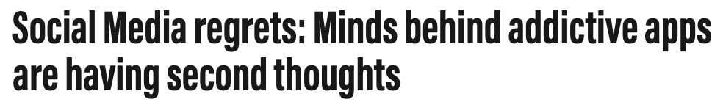
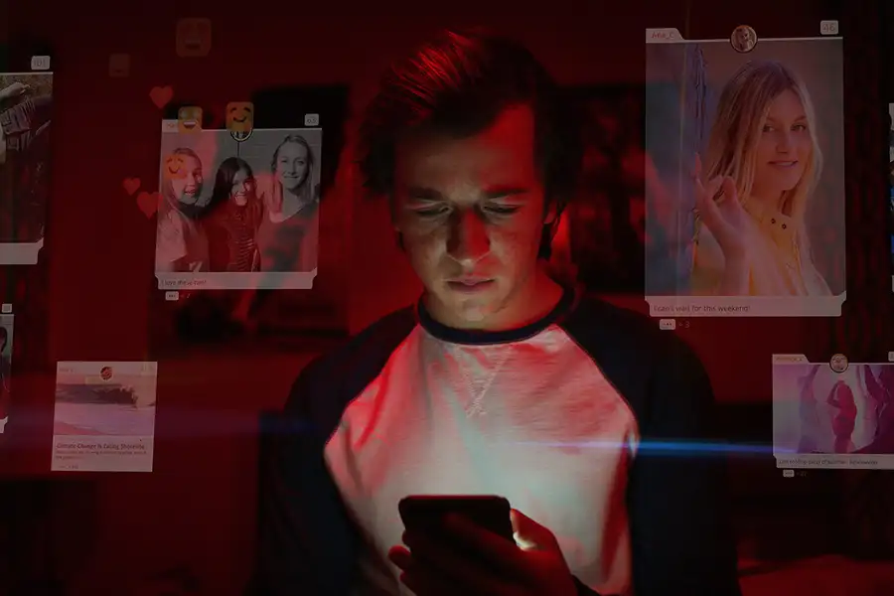
“If you’re not paying for the product, then you are the product”
(Tristan Harris, former Google Design Ethicist)
www.thenationalnews.com
we pay with
our data, time and attention
“Attention Economy”
Algorithms to maximize for user’s attention
=> maximize for gratitude
Source: Social Dilemma (2020), Documentary/Thriller
Notes:
It has too much text and will take the audience quite some time to read that

Slide 4
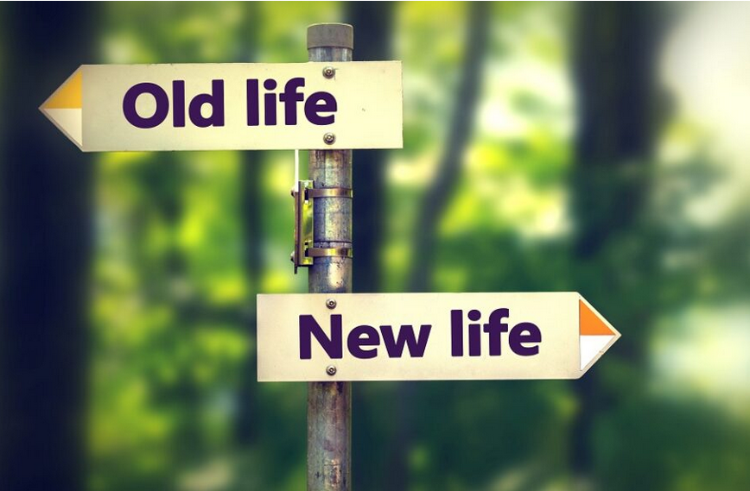
Changing People’s Lives with Gratitude
Gratitude Maximizer:
Philipp Trinh & Alla Abrosimova
Notes:
The motivation behind our project …

Slide 5
Analyzing gratitude in Youtube comments
Our aim: recommending videos based on gratitude in the comments
Comparing YouTubers based on gratitude score
Creating a Streamlit app that will order videos by gratitude score
Notes:
-hard to quantify,but we came up…..based on that score…

Slide 6
Preprocessing & Gratitude Score
Data extraction, cleaning, transformation for further modeling
Dictionary e.g.: thank you, inspiring, life-changing, appreciate=> (labeled: 1 = with gratitude vs 0 = no gratitude):
Test dataset: 267K comments (5 videos * 13 youtubers)
Gratitude score = (grateful comments / total comments) * 100
Notes:
50-sec How we did that:
267K comments

Slide 7
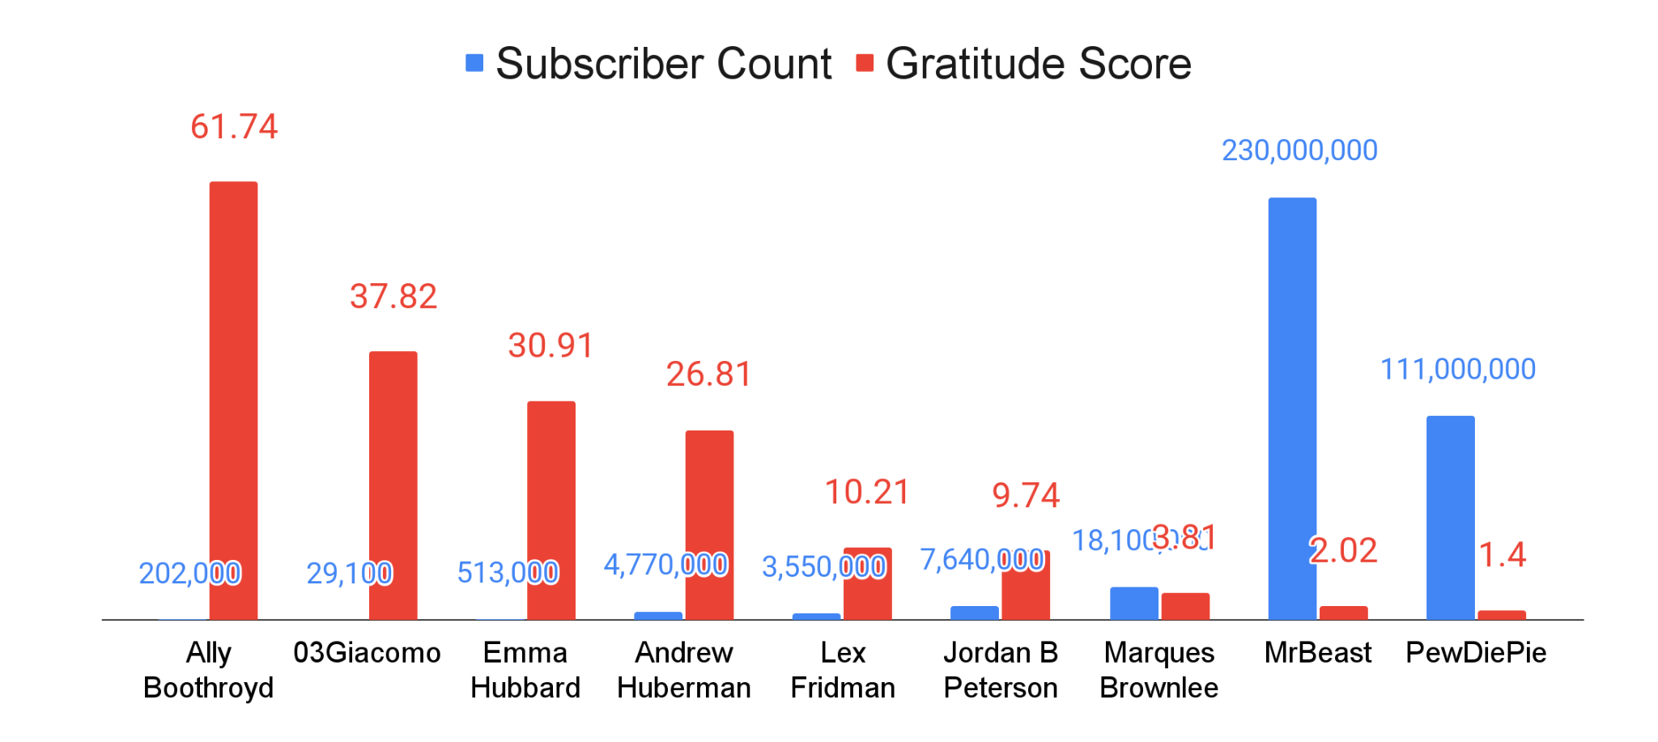
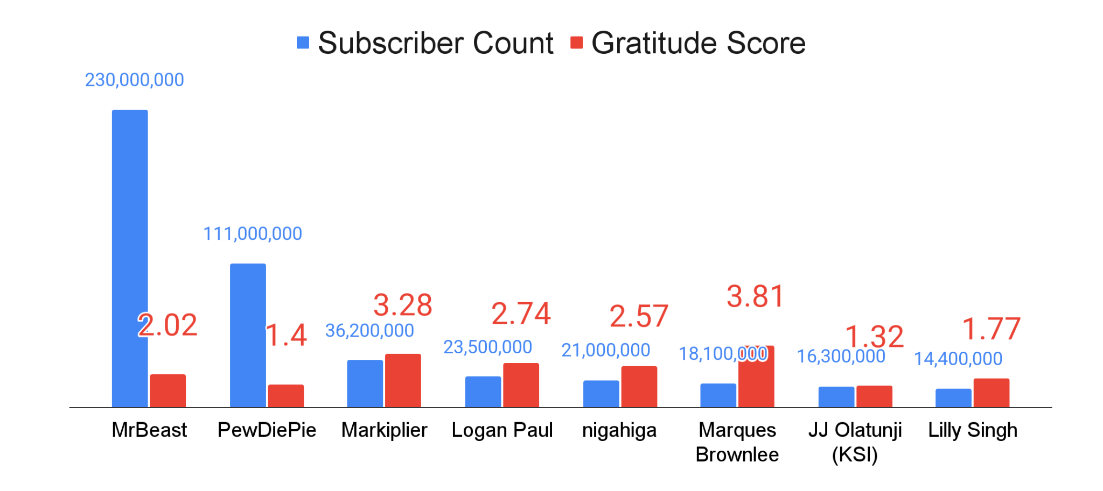
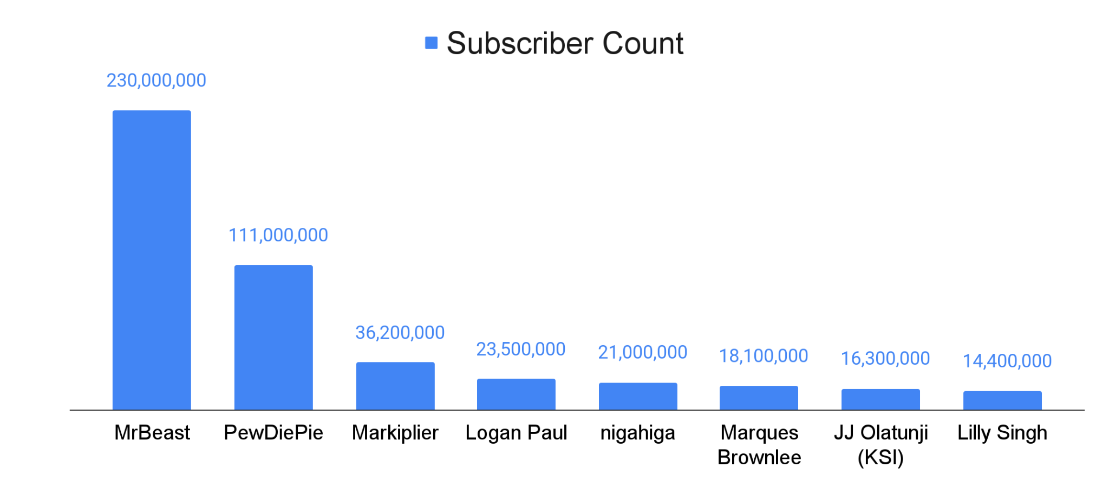
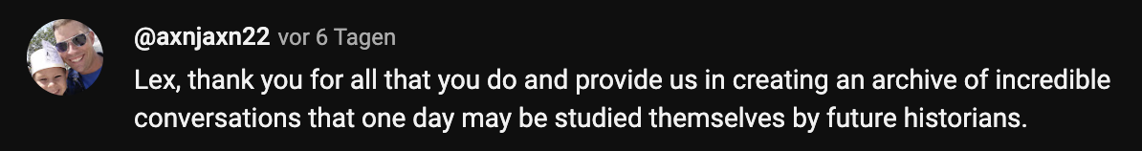
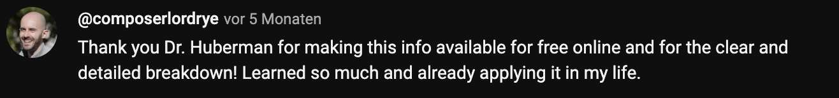
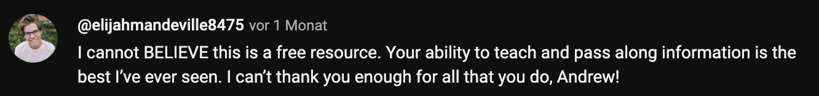

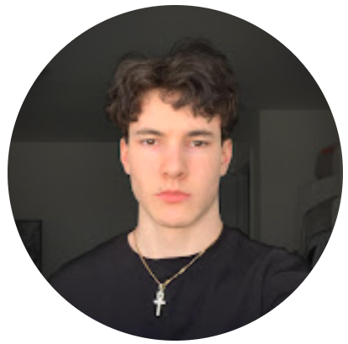

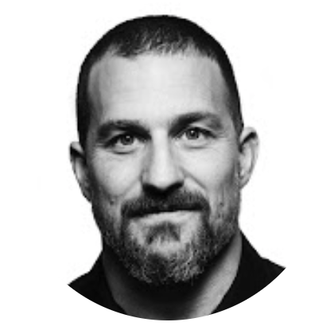
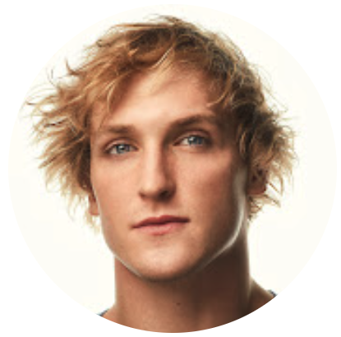
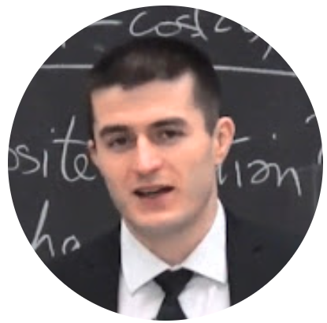
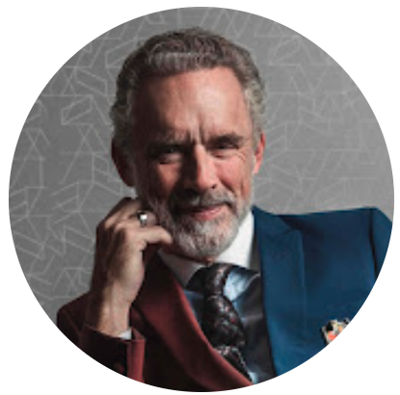




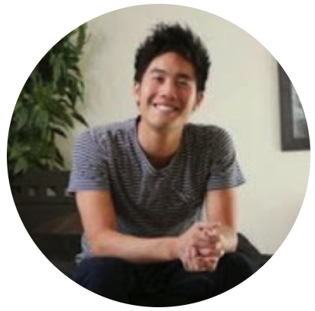


Comparing YouTubers

Slide 8
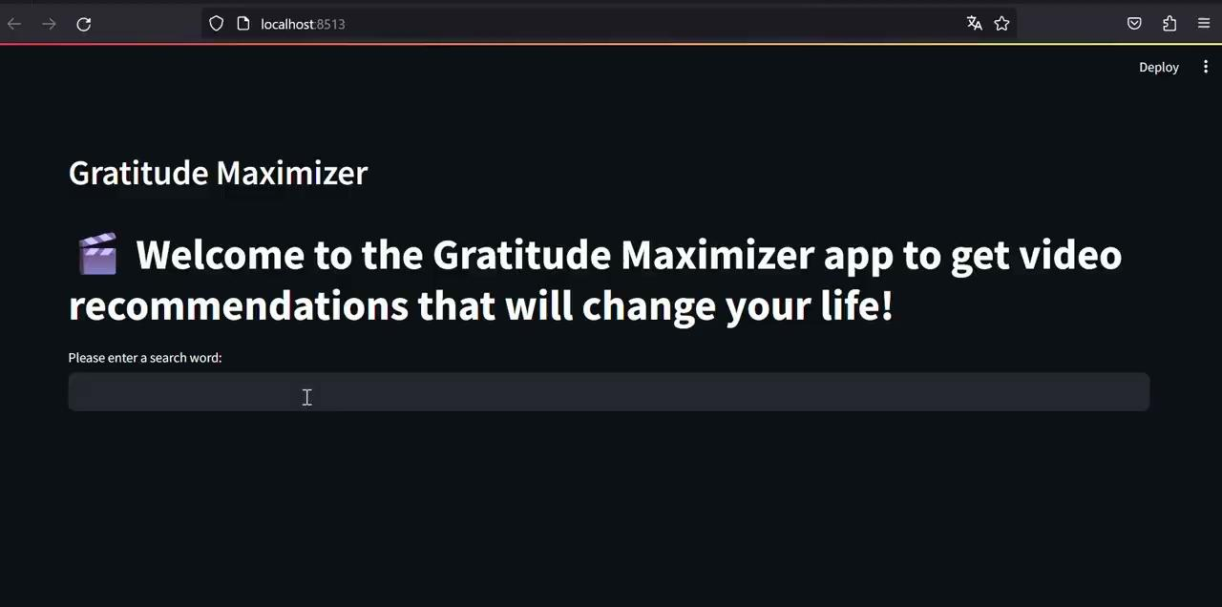
Streamlit App:
Notes:
1 min. Our final product: not based on the viewer count
-helps me decide- what useful

Slide 9
Outlook:
Optimize comment extraction time on our Streamlit App
Comments from other social media platforms
Infiltrate YouTube and other social media apps to adjust their algorithms according to our Gratitude Score 🙂
Notes:
30 sec

Slide 10

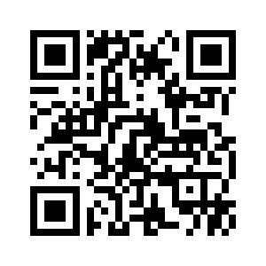


Thank you for your attention!

Slide 11
Appendices

Slide 12
“It literally changes your relationship with society, with each other. God only knows what it’s doing to our children’s brain”
(Sean Parker, former Facebook president)
www.thenationalnews.com
“All of our minds can be hijacked. Our choices are not as free as we think they are.”
(Tristan Harris, former Google Design Ethicist)
“If you’re not paying for the product, then you are the product” (Tristan Harris)
Your data, time and attention
“Attention Economy”
Algorithms to maximize for user’s attention
Source: Social Dilemma (2020), Documentary/Thriller
Notes:
It has too much text and will take the audience quite some time to read that

Slide 13
Can machines recognize gratitude?
Project aim & steps:
Aim: analyzing gratitude in Youtube comments using convolutional neural networks (CNNs) and LSTM (Long Short Term Memory) models
comment extraction (top influential youtubers)
data cleaning, preprocessing
test neural networks
classifying/comparing youtubers based on gratitude score
creating playlists with high gratitude score content

Slide 14
Datasets
Data extraction, cleaning, transformation for further modeling (labeled: 1=gratitude vs 0=no gratitude):
Trainset: 43K comments
Validation dataset: 20K
Test dataset: 267K (5 videos * 13 youtubers)

Slide 15


Preprocessing & Models we tested so far:
Bert Tokenizer + Bert Model (not for our data, compatibility issues)
Keras Tokenizer + CNN LSTM (99.67 test accuracy on 40K dataset)
Trained our data on 40K dataset
Predicted gratitude in 267K dataset

Slide 16
Models:
BERT:
Bidirectional Encoder Representations from Transformers is a language model
uses attention mechanisms to capture contextual relationships between words in a sentence. It processes entire sentences in parallel, considering the context of each word in relation to the entire sentence
CNN-LSTM hybrid:
Convolutional Neural Network & Long Short Term Memory model
CNNs are effective at capturing local patterns, while LSTMs excel at modeling sequential information.

Slide 17

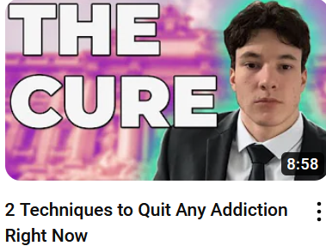
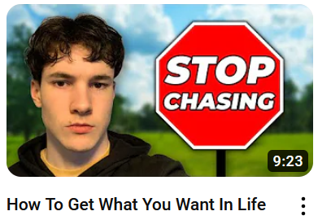

Gratitude playlist
Contents | YouTuber | Gratitude score | Link
 | Boothroyd | 74 | https://www.youtube.com/watch?v=agiU-TVrVcw
 | Giacomo | 65 | https://www.youtube.com/watch?v=K8OMEM6qGoc
 | Giacomo | 56 | https://www.youtube.com/watch?v=FQ-57X9iCcA
 | Boothroyd | 55 | https://www.youtube.com/watch?v=YQgyoX-1qq0

Slide 18
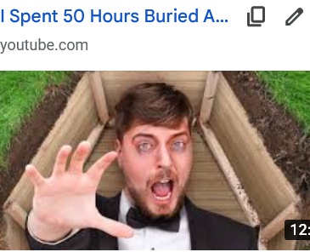
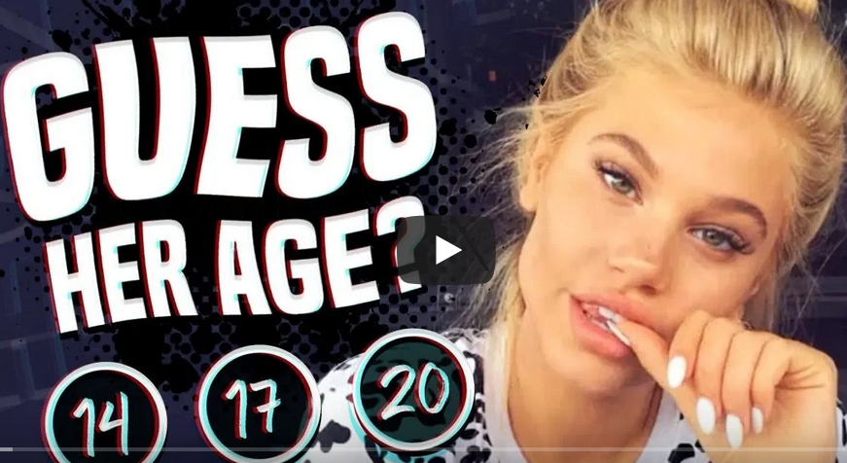
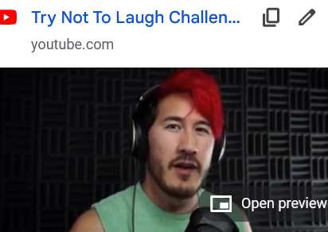
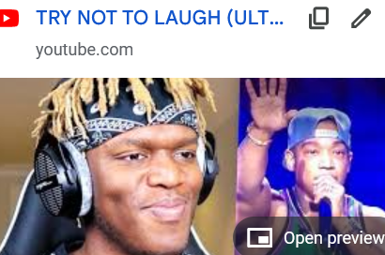
Entertainment Playlist
Contents | YouTuber | Gratitude score | Link
 | MrBeast | 1.2 | https://www.youtube.com/watch?v=9bqk6ZUsKyA
 | KSI | 1.2 | https://www.youtube.com/watch?v=-NtadR0-ino
 | Markiplier | 1.2 | https://www.youtube.com/watch?v=BQw3v31s-Y8
 | KSI | 1.2 | https://www.youtube.com/watch?v=fvpwcK7Ckf8

Slide 19
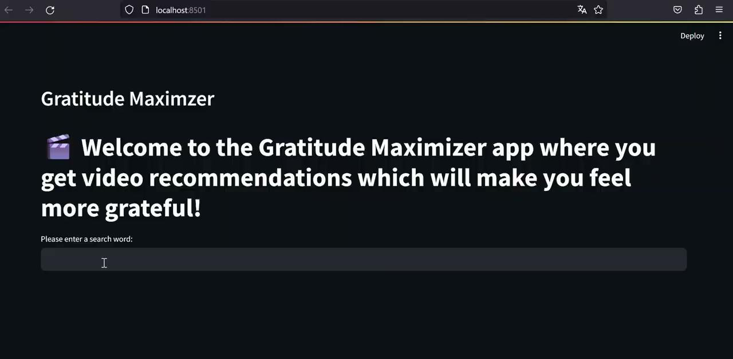
Streamlit App:
Notes:
1 min. Our final product: not based on the viewer count
-helps me decide- what useful

